Slide 1
Actions happening.. right now!

Slide 2
What can you see in this picture?

Slide 3
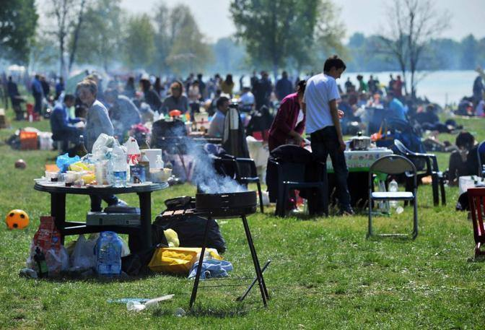

Slide 4
What type of mistake do these sentences have in common?
I write you to explain the problem
I contact you in order to make a copy
Dear teacher, I send you my English homework

Slide 5
Present continuous
Why do we use it in this case?

Slide 6
Present continuous
When we talk about something happening right now, while we speak or write, we use present continuous.
Examples:
I am writing
I am sending
I am requesting

Slide 7
Focus on form
What are the elements that compose present continuous?
SUBJECT + TO BE + VERB IN -ING FORM
Example: The teacher is talking a lot right now.

Slide 8
What are the people in the photo doing?

Slide 9
Describe the actions in this picture

Slide 10
What are they doing right now?
Verbs to help you:
to bite
to sit
to smile

Slide 11
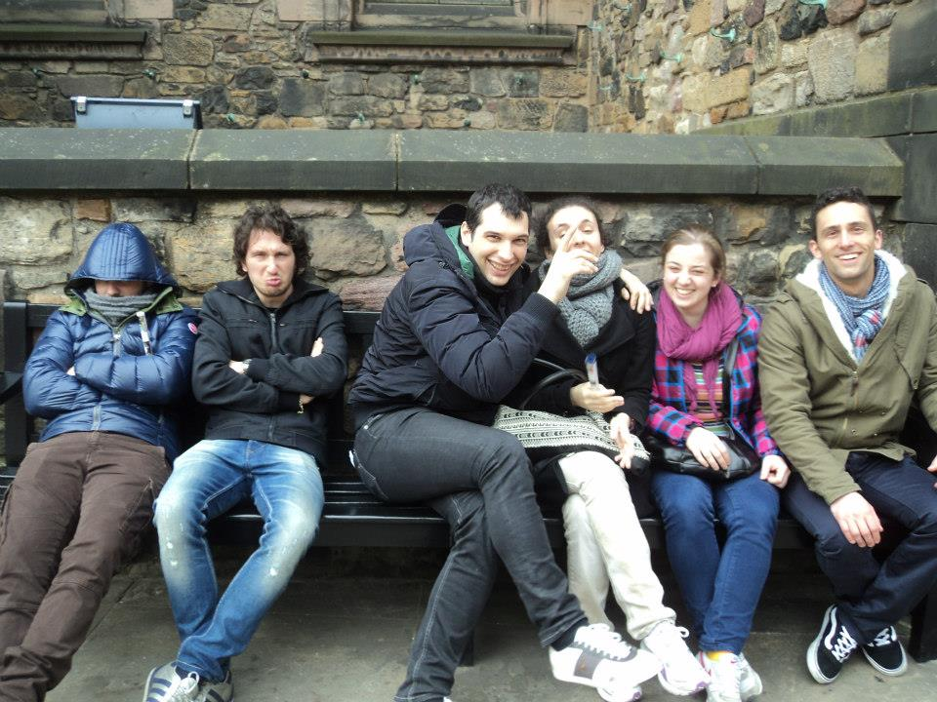

Slide 12
What are you doing right now?

Slide 13
Do you know the song Lemon Tree?
Listen to the song and use these verbs to fill in the blanks:
https://www.youtube.com/watch?v=bCDIt50hRDs
sit hang wait happen wait
sit
be wonder waste drive be wonder

